Slide 1
Intro To Programming JavaScript

Slide 2
Brief Summary Of Chapter 4
What is an Object
Combining Arrays and Objects
Chapter 4: Objects

Slide 3
An object is a fundamental data structure in programming that represents a collection of related information. Think of an object as a container that holds data in the form of properties. Each property consists of a key and a value. The key is like a name or identifier for the property, and the value is the actual data associated with that key.
For example, imagine a "person" object. It might contain properties like "name," "age," and "isStudent," where each property holds specific information about that person.
What is an Object?

Slide 4
Working with Objects: Defining, Accessing, and Modifying Properties:
Curly brackets {} define an object with its properties and values. While you can use the new Object() syntax, it’s less common and generally considered less clear.
Keys can be written without quotes if they are valid identifiers. For keys with spaces, special characters, or starting with numbers, quotes are required.
To access object values, use either dot or bracket notation:
Dot: const name = person.name;
Bracket: const age = person["age"];
To retrieve all keys from an object, use Object.keys():
const keys = Object.keys(person);
You can add new key-value pairs using dot or bracket notation:
Dot: person.country = "USA";
Bracket: person["occupation"] = "Engineer";
To retrieve all values from an object, use Object.values():
const values = Object.values(person);

Slide 5
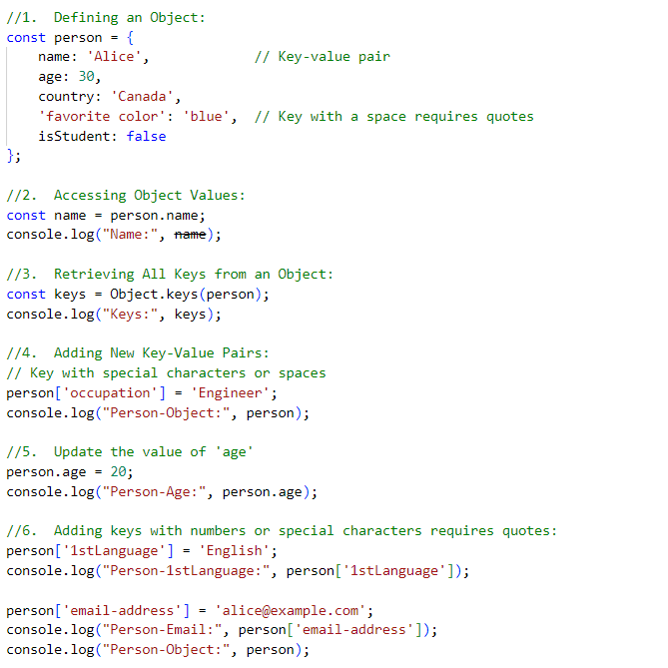

Slide 6
Combining arrays and objects in JavaScript allows for efficient data management and organization. Arrays can store multiple objects, and each object can hold various properties. This structure helps in representing complex data, such as lists of items or nested data, making it easier to access, manipulate, and work with related data. It also supports advanced operations like filtering and consolidation, and is commonly used in APIs and real-world applications.
Combining Arrays and Objects

Slide 7
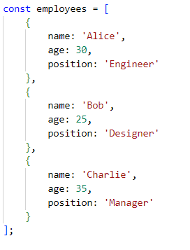
A structure of Define an array of objects:

Slide 8
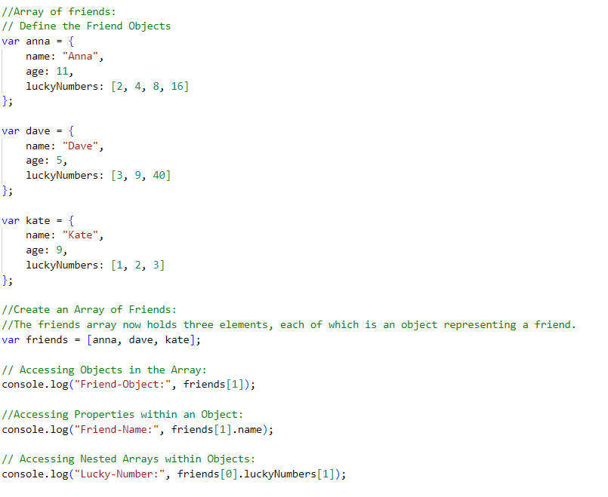
EXAMPLE: B-p96 - 97 & L-p69 - 70

Slide 9

Do the programming challenges then upload to github.
Page (B-103 & L-76)
Practice Exercises

Slide 10

End Of Chapter 4

